Slide 1
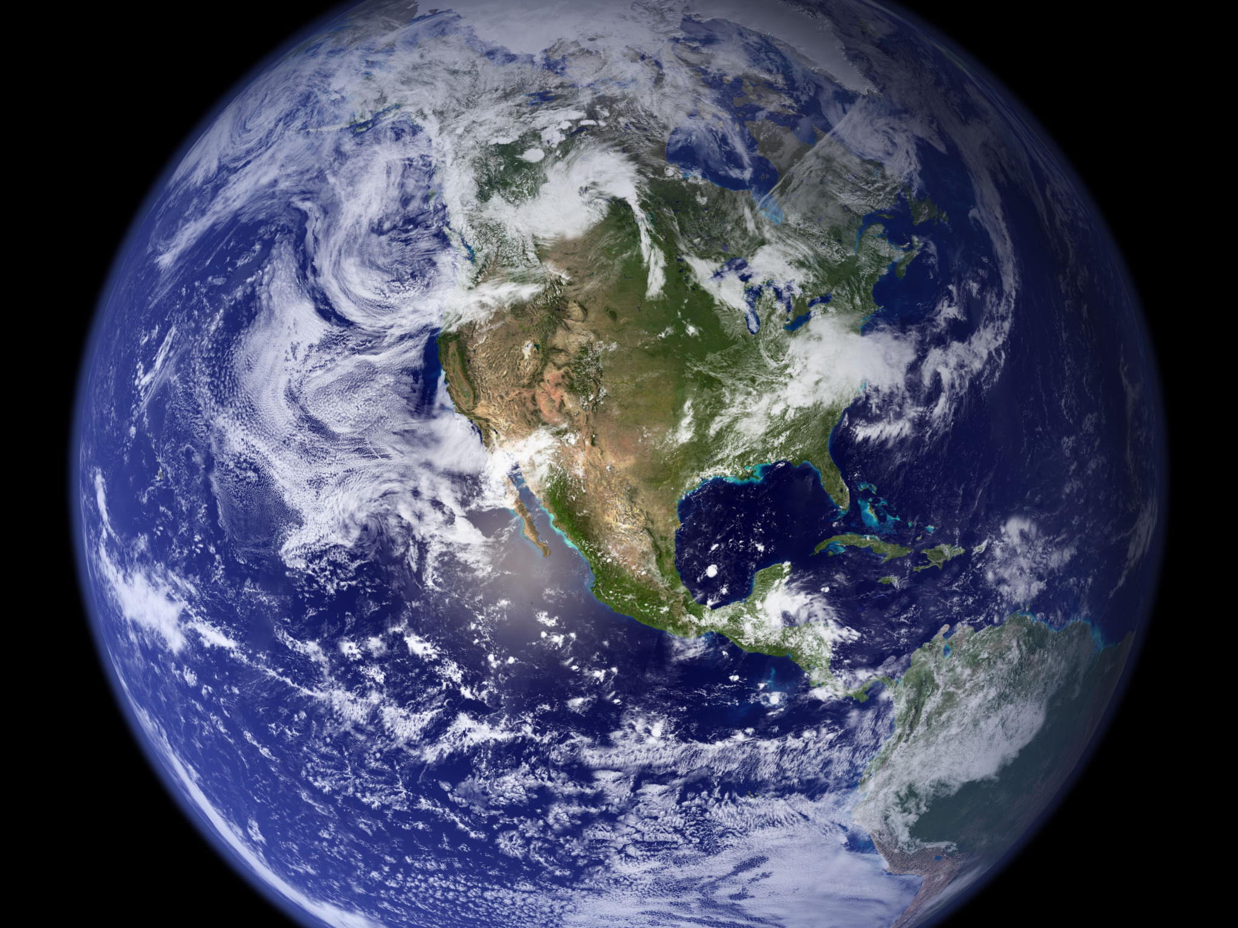
Image courtesy of NASA/GSFC

Slide 2
Assessment of Potential Impacts of Climate Changes on Iowa Using Current Trends and Future Projections
Eugene S. Takle
Director, Climate Science Initiative
Professor of Atmospheric Science
Department of Geological and Atmospheric Sciences
Professor of Agricultural Meteorology
Department of Agronomy
Iowa State University
Ames, Iowa 50011
gstakle@iastate.edu
House of Representatives
Environmental Protection Committee
Iowa Legislature
Des Moines
13 January 2010

Slide 3
Outline
Quick overview of global climate changes
Examples of recent climate change in Iowa
Assessment of future climate change for Iowa
Impacts of climate change for Iowa

Slide 4
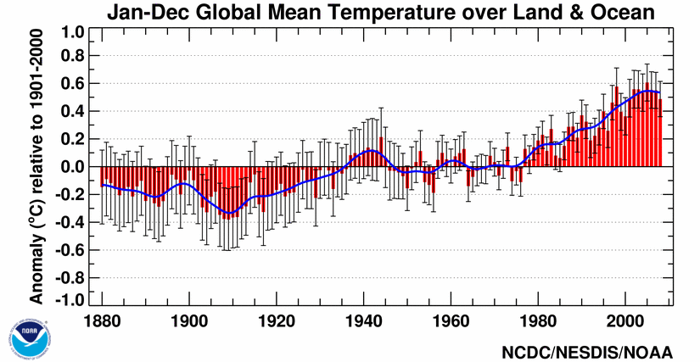
Global Mean Surface Temperature
I
II
III
IV
http://www.ncdc.noaa.gov/img/climate/research/2008/ann/global-jan-dec-error-bar-pg.gif

Slide 5
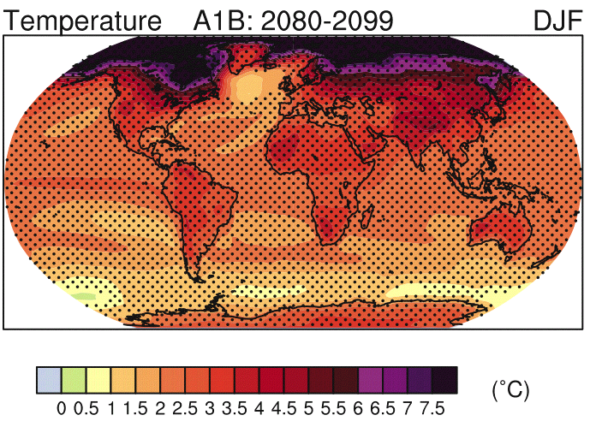

Slide 6
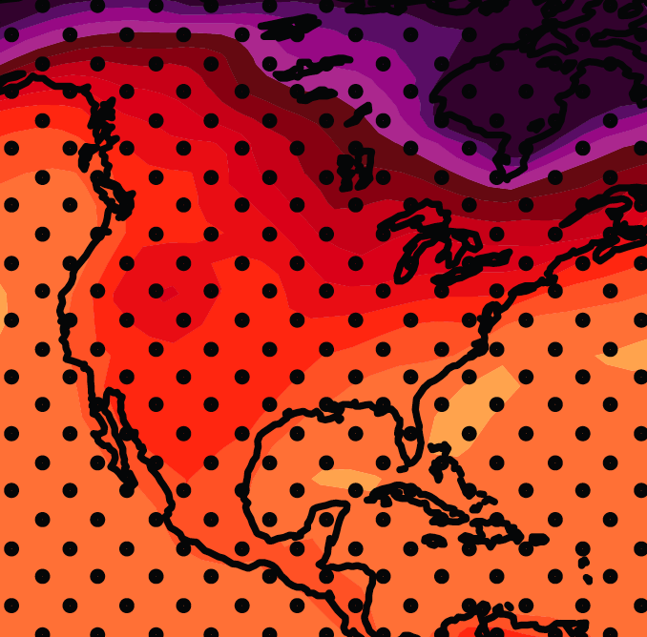
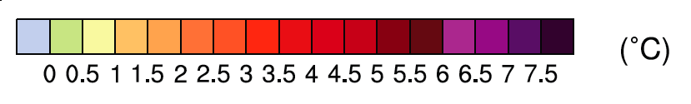
December-January-February Temperature Change
4.0
3.5
A1B Emission Scenario
2080-2099 minus1980-1999

Slide 7
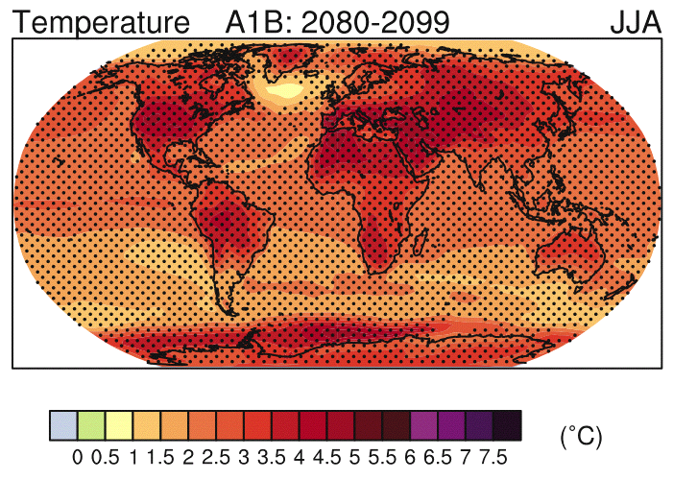

Slide 8
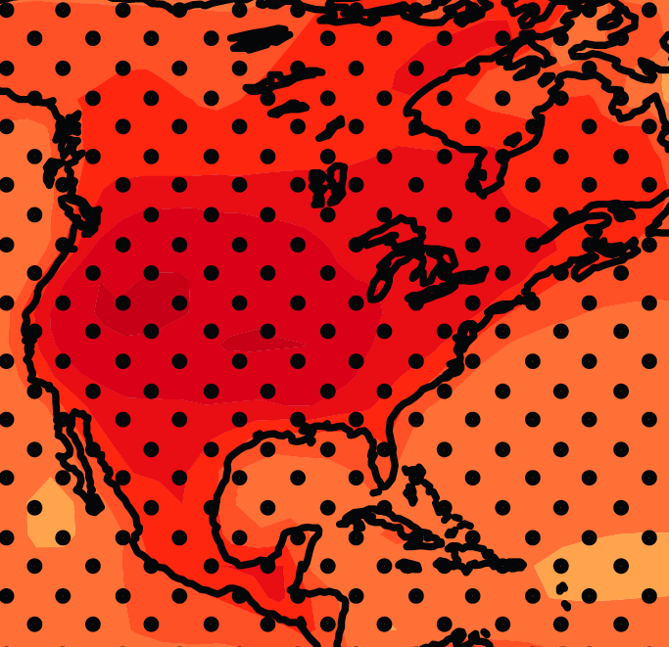
June-July-August Temperature Change
2.5
A1B Emission Scenario
2080-2099 minus1980-1999
3.0

Slide 9
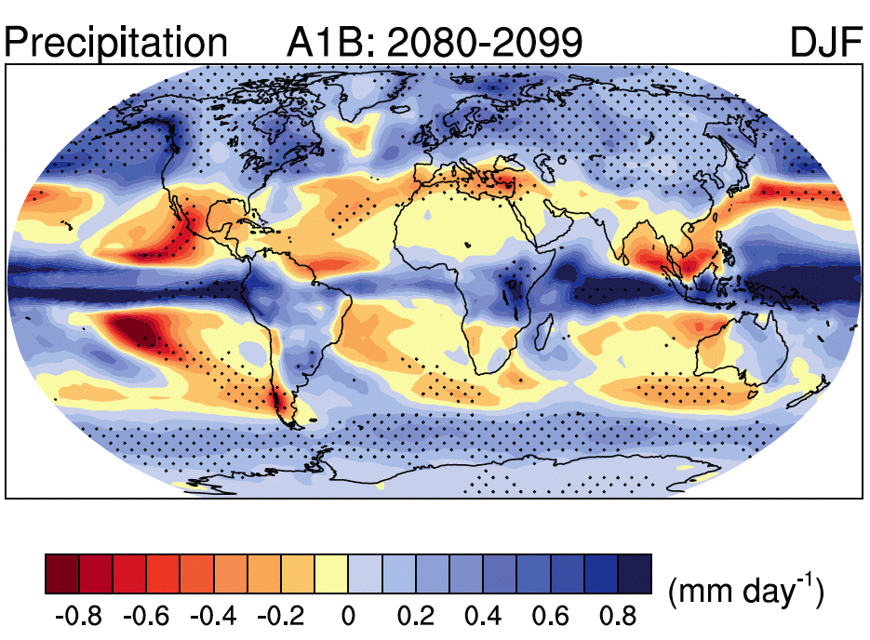
Source: IPCC 4th Assessment Report, 2007

Slide 10
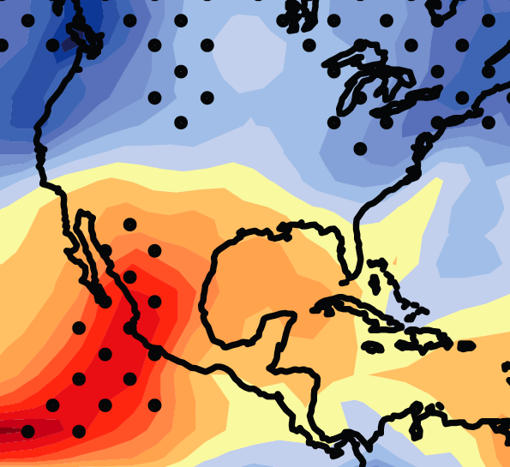

December-January-February Precipitation Change
0.1
0.0
A1B Emission Scenario
2080-2099 minus1980-1999

Slide 11
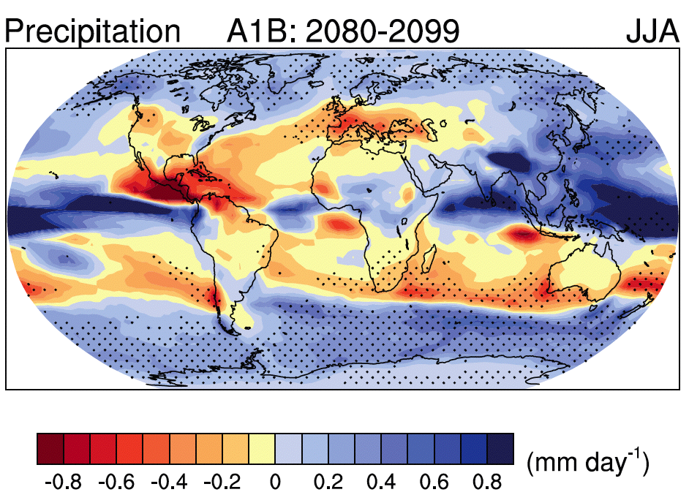
Source: IPCC 4th Assessment Report, 2007

Slide 12
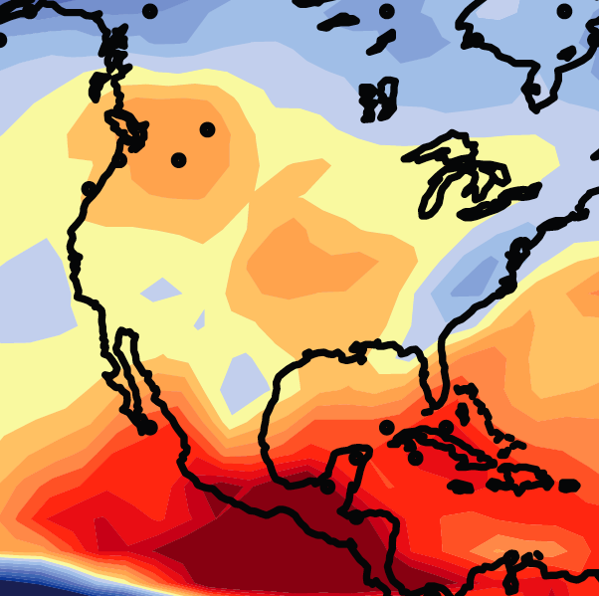
June-July-August Precipitation Change
0.0
-0.1
A1B Emission Scenario
2080-2099 minus1980-1999

Slide 13
Observed Summer (JJA) Daily Maximum Temperature
Changes (K), 1976-2000
Adapted from Folland et al. [2001]

Slide 14
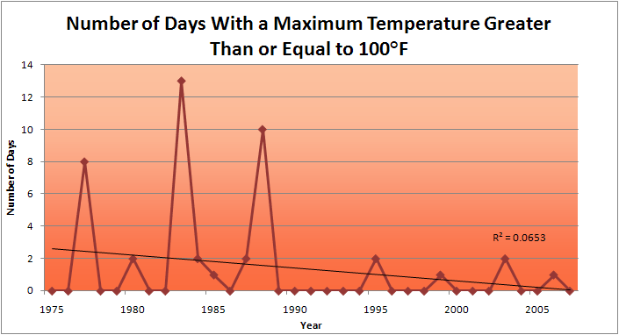
Des Moines Airport Data
1983: 13
1988: 10
2009: 0

Slide 15
Des Moines Airport Data
1983: 13
1988: 10
6 days ≥ 100ºF in the last 20 years
2009: 0

Slide 16
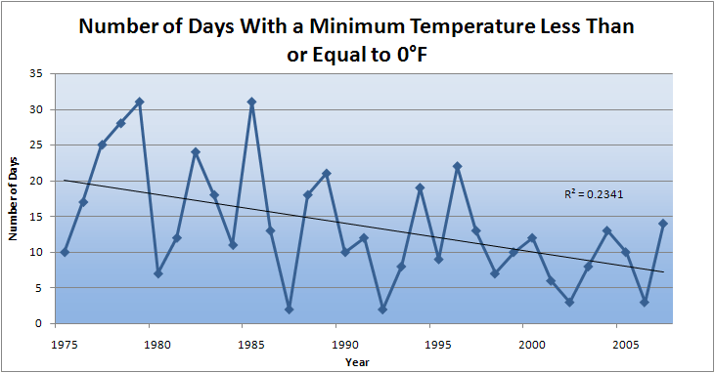
Des Moines Airport Data
2010
2009

Slide 17
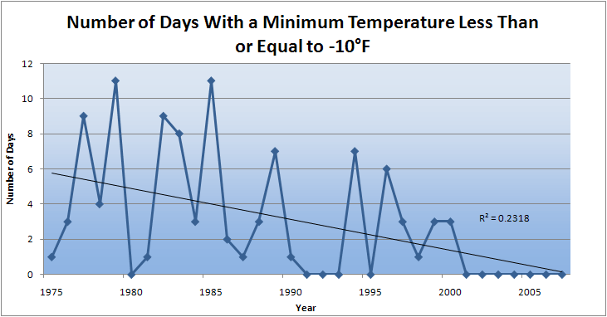
Des Moines Airport Data
Average 1976-2005: 3.2 days/yr
2010
2009

Slide 18
Des Moines Airport Data
Caution: Not adjusted for possible urban influence
Average 1976-2005: 3.2 days/yr
2010
2009

Slide 19
Ames Data

Slide 20
Ames Data
Ave 1971-2000

Slide 21
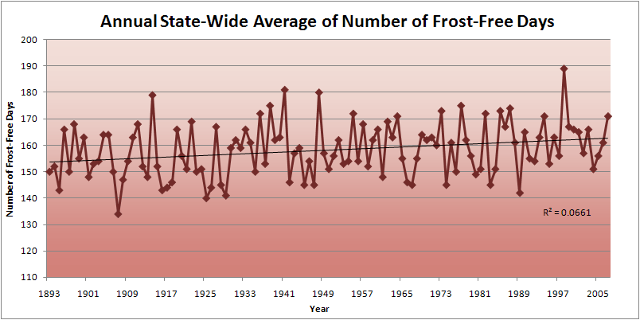
State-Wide Average Data

Slide 22
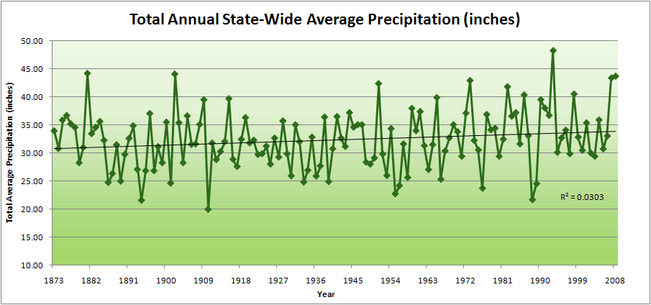
State-Wide Average Data

Slide 23
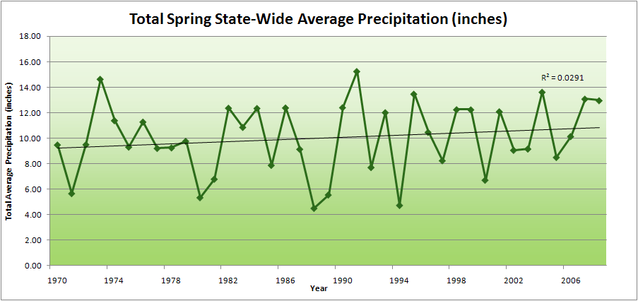
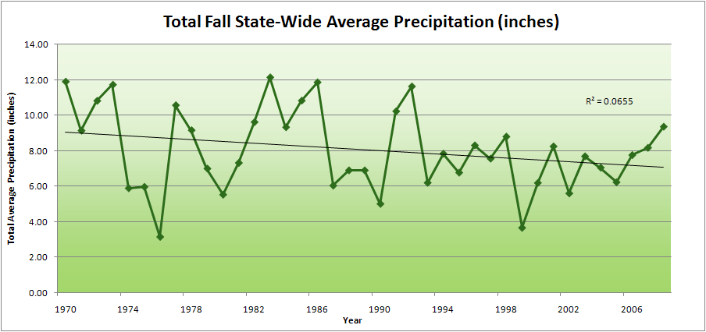

Slide 24
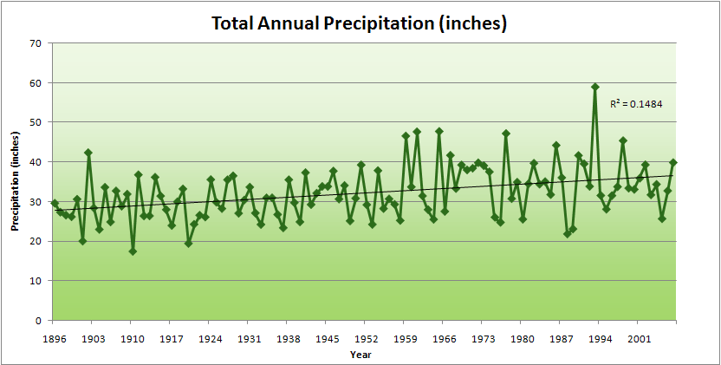
Cedar Rapids Data

Slide 25
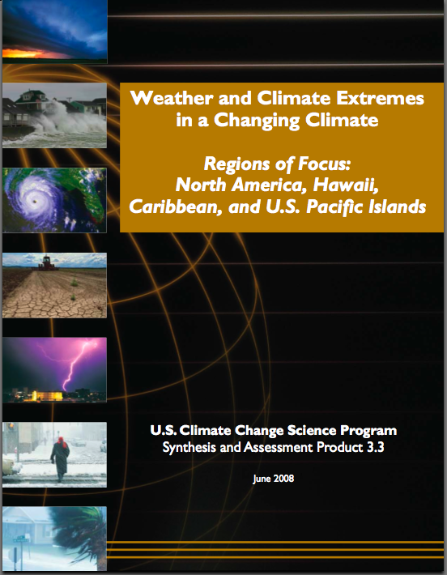
“One of the clearest trends in the United States observational record is an increasing frequency and intensity of heavy precipitation events… Over the last century there was a 50% increase in the frequency of days with precipitation over 101.6 mm (four inches) in the upper midwestern U.S.; this trend is statistically significant “

Slide 26
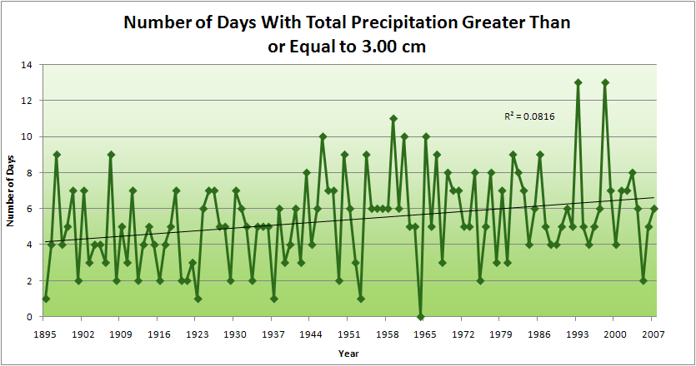
Cedar Rapids Data

Slide 27
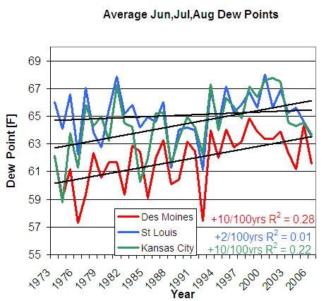
D. Herzmann, Iowa Environmental Mesonet

Slide 28
Projected Changes* for the Climate of the Midwest Temperature
Longer frost-free period (high)
Higher average winter temperatures (high)
Fewer extreme cold temperatures in winter (high)
Fewer extreme high temperatures in summer in short term but more in long term (medium)
Higher nighttime temperatures both summer and winter (high)
More freeze-thaw cycles (high)
Increased temperature variability (high)
Follows trend of last 25 years and projected by models
No current trend but model suggestion or current trend but model inconclusive
*Estimated from IPCC reports

Slide 29
Projected Changes* for the Climate of the Midwest Precipitation
More (~10%) precipitation annually (medium)
Change in “seasonality”: Most of the increase will come in the first half of the year (wetter springs, drier summers) (high)
More water-logging of soils (medium)
More variability of summer precipitation (high)
More intense rain events and hence more runoff (high)
Higher episodic streamflow (medium)
Longer periods without rain (medium)
Higher absolute humidity (high)
Stronger storm systems (medium)
More winter soil moisture recharge (medium)
Snowfall increases (late winter) in short term but decreases in the long run (medium)
Follows trend of last 25 years and projected by models
No current trend but model suggestion or current trend but model inconclusive
*Estimated from IPCC reports

Slide 30
Projected Changes* for the Climate of the Midwest Other
Reduced wind speeds (high)
Reduced solar radiation (medium)
Increased tropospheric ozone (high)
Accelerated loss of soil carbon (high)
Phenological stages are shortened (high)
Weeds grow more rapidly under elevated atmospheric CO2 (high)
Weeds migrate northward and are less sensitive to herbicides (high)
Plants have increased water used efficiency (high)
Follows trend of last 25 years and projected by models
No current trend but model suggestion or current trend but model inconclusive
*Estimated from IPCC and CCSP reports

Slide 31
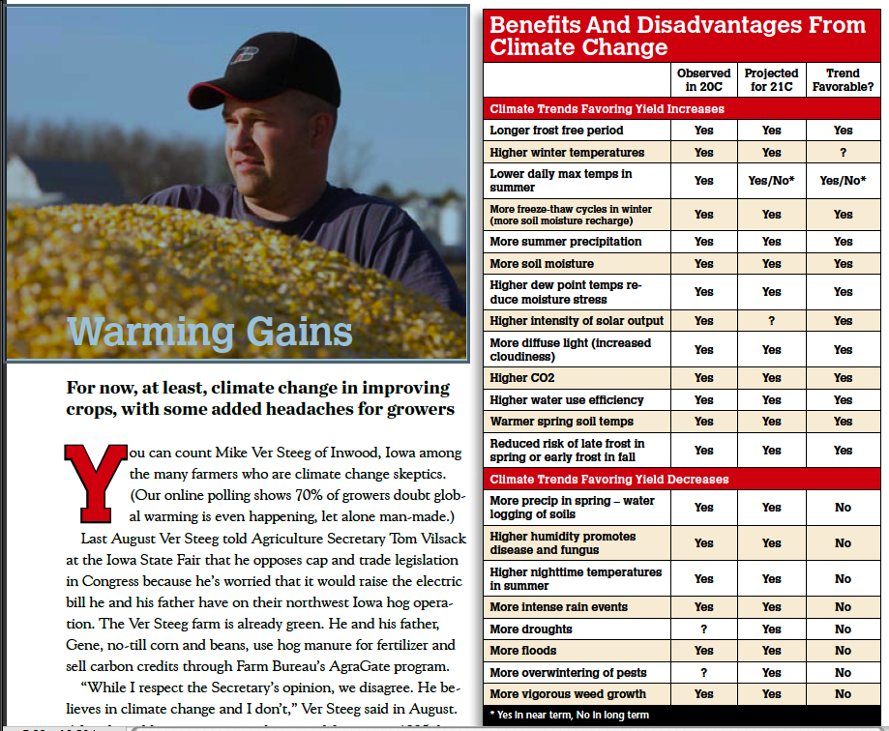
Successful Farming Jan 2010
Dan Looker
(used by permission)

Slide 32
Summary of Impacts: Agriculture
Droughts and floods
Soil erosion
Accelerated weed growth
Soil carbon gain or loss
Commodity crops
Frost-free days
Last spring frost, first fall frost
Intensive heat during pollination
Pests and pathogens
Fungus, molds, toxins
Soils compaction
Water logging of soils
Fall crop dry-down
Harvest conditions
Hail
Energy crops
Specialty crops
Animal agriculture
Milk and egg production
Breeding success
Weight gains in meat animals
Animal health (heat, freezing precipitation)
Disease
Agricultural soil drainage
Pests and pathogens
More favorable conditions due to higher humidity and more leaf wetness
More overwintering due to more mild winter temperatures
Impact of wind farms on crops
List likely not complete

Slide 33
Summary of Impacts: Water
Lakes and streams
Water quantity
Water quality
Recreation impacts
Aquatic ecosystems
Streamflow, major rivers
Transportation disruption
Ecosystem resilience
Flooding
Increased installation of drainage tile changes peak flow
Reservoirs
Managing water levels
More extreme precipitation events
Increased installation of drainage tile changes inflow rates
Siltation
Rural and urban water supplies
Quantity
Quality
List likely not complete

Slide 34
Summary of Impacts : Other
Human Health
Heat waves
Disease vectors
Hazard mitigation (health effects of floods)
Molds
more groundwater and wet basements
higher ambient dew point temperatures
Ecosystems
Functioning
Invasive species
Ecosystem services
Fish and wildlife
Energy Production and consumption
Wind power resource availability
Solar power resource availability
Biomass
Energy demand
Infrastructure
Roads, bridges
Building codes
Communities
Planning (flood plain, energy conservation)
Water systems
List likely not complete

Slide 35
For More Information
Contact me directly:
gstakle@iastate.edu
Current research on regional climate and climate change is being conducted at Iowa State University under the Regional Climate Modeling Laboratory
http://rcmlab.agron.iastate.edu/
North American Regional Climate Change Assessment Program
http://www.narccap.ucar.edu/
For current activities on the ISU campus, regionally and nationally relating to climate change see the Climate Science Initiative website:
http://climate.agron.iastate.edu/
Or just Google Eugene Takle

Slide 36
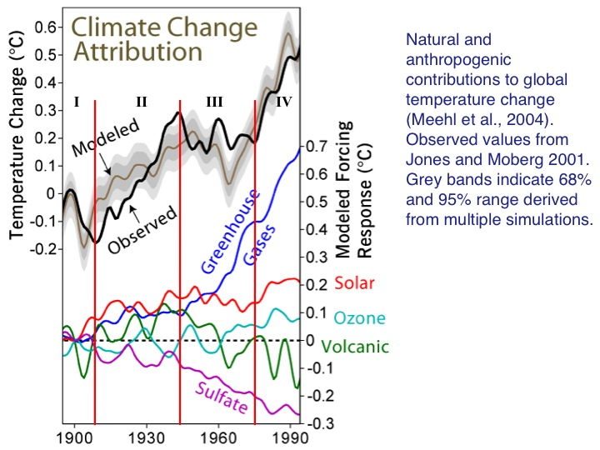

Slide 37
Cooling Decade in a Century of Warming
Probability of a cooling decade in a century of warming
Probability distribution functions for decadal trends (kelvin/year) in globally averaged surface air temperature
Easterling, D. R., and M. F. Wehner, 2009: Is the climate warming or cooling? Geophys. Res. Lett., 36, L08706, doi:10.1029/2009GL037810, 2009

